Slide 1
Interpretable Bag-of-Visual Words Networks for Adversarial Example Detection
Krishna Kanth Nakka and Mathieu Salzmann
CVLab, EPFL
Presented by Krzysztof Lis, CVLab, EPFL

Slide 2
Research Goal
Understanding how deep neural network makes predictions, as well as when and why they make errors
Detection of malicious samples in the case of adversarial attacks
Notes:
1.Understanding internal dynamics of neural network predictions through semantic codewords
2. Leverage semantic codewords to detect adversarial samples

Slide 3
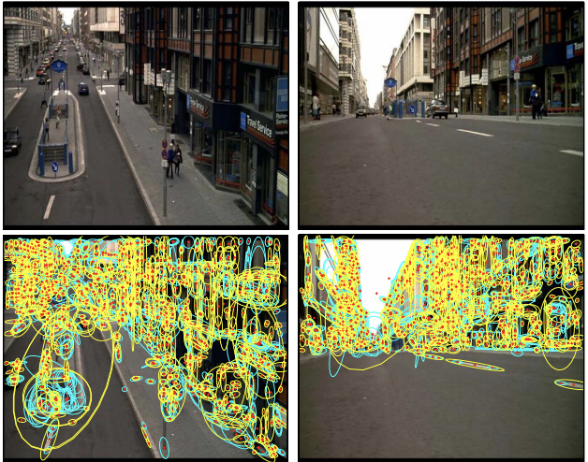
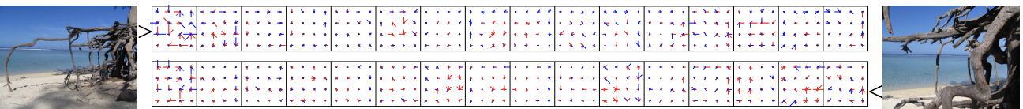
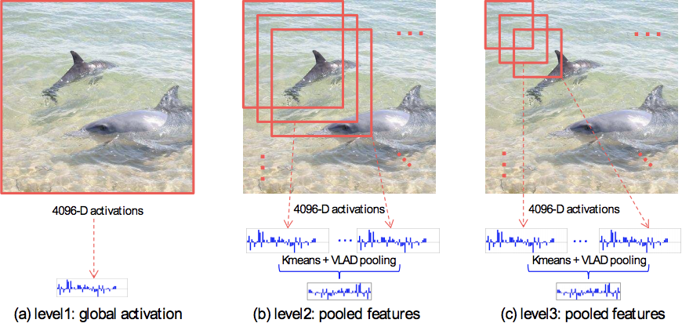
Structured Representations
A Text Retrieval Approach to Object Matching in Video
[Sivic et al., 2003]
Aggregating local descriptors into compact codes
[Herve et al., 2010]
Deep Structured Networks
Multiscale Orderless Pooling
[Gong et al., 2014]
Notes:
Sivic et al. Text retrieval – First usage of bag of words in Image domain for task of image retrieval
Herve et al., Aggregates local descriptors through VLAD pooling
Gong et al.,– First usage of VLAD, BoW on extracted CNN features

Slide 4
Structured Representations
A Text Retrieval Approach to Object Matching in Video
[Sivic et al., 2003]
Aggregating local descriptors into compact codes
[Herve et al., 2010]
Deep Structured Networks
Multiscale Orderless Pooling
[Gong et al., 2014]
NetVLAD, FisherNet
[Arandjelović et al., 2016]
[Peng et al., 2017]
Notes:
Sivic et al. Text retrieval – First usage of bag of words in Image domain for task of image retrieval
Herve et al., Aggregates local descriptors through VLAD pooling
Gong et al.,– First usage of VLAD, BoW on extracted CNN features
Arandielovic et al., NetVLAD- First end to end netVLAD and netBoW model

Slide 5
Structured Representations

Slide 6
Structured Representations
^{Stage 1}
^{Stage 2}
^{Stage 3}
^{Local features}
^{Aggregation}
^{Retrieval}
Large scale image retrieval framework
Different types of Aggregation: BoW, VLAD, Fisher
Herve et al., Aggregating local descriptors into compact codes, 2010
Notes:
Standard BoW pooling: extract local features and aggregate them using one of the pooling techniques

Slide 7
Classical Bag of Words Model
Notes:
BoW: each local feature is assigned to the nearest cluster with a hard assignment

Slide 8
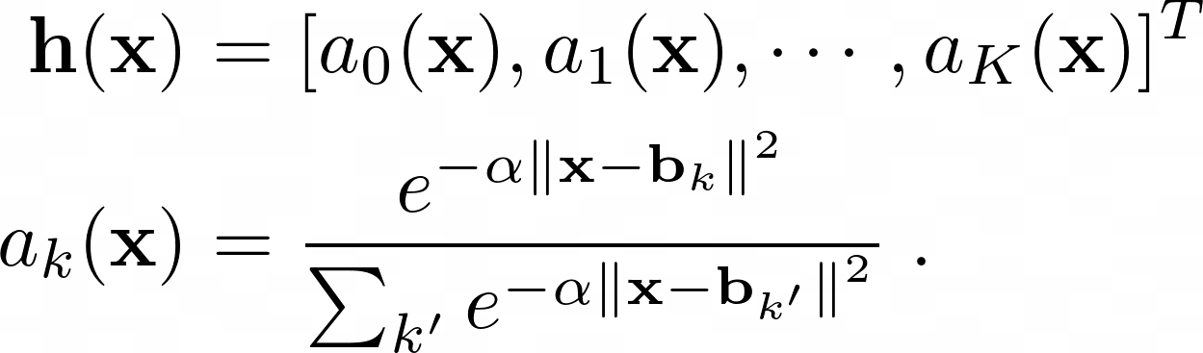
Net Bag of Words layer in CNNs
Soft assignment policy of features to the codewords
x is a D-dimensional feature vector extracted at final convolutional layer B is learnable Codebook with K codewords each of D-dimension
h(x) – BoW representation
Notes:
BoW: each local feature is assigned to the nearest cluster with a hard assignment

Slide 9
Interpretable Codebook
Interpret the decisions of a CNN by assigning a visual representation to the codewords
We propose to learn semantic codewords in an end-to end manner using pre-trained generative adversarial networks
airplane
airplane
Codebook

Slide 10
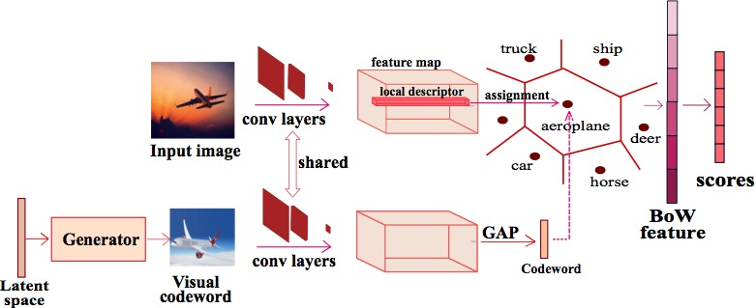
Interpretable Codebook
NetBoW model with BoW layer on the top of the network
horse
airplane
airplane
Codebook
Notes:
An input image is passed through the backbone to extract feature map
Each local feature is assigned to codeword basing on soft weighting [Euclidean distance between feature and codeword]

Slide 11
Interpretable Codebook
Jointly optimize the latent space of GAN and BoW network
horse
airplane
airplane
pretrained
Codebook
Notes:
1. A pretrained GAN is used to generate a visual codeword
2. this visual codeword is passed through base network and extracted global pooled feature is taken as the codeword representation. Similarly, we global pool as local descriptors into single vector and extract bow representation from it.
3. End to end trainable system ( although we don’t do it now, alternate optimization between bow network and latent space of GAN can be done)
4. We optimize the latent space of GAN to generate the visual codeword that is close to the trained BoW codewords.

Slide 12
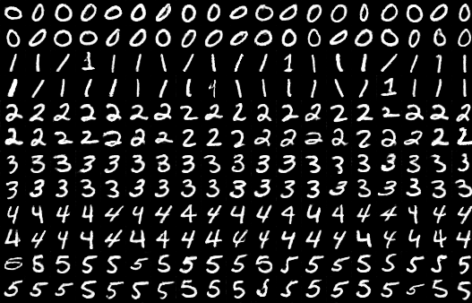
Visualization of Semantic Dictionaries
Learned codewords per class on MNIST dataset
airplane
airplane
Codewords captures different shapes and orientation in the dataset
Codebook
Notes:
Visualization of trained codewords in an end-to-end manner.
Every two rows correspond to trained codewords for a single class. First two rows correspond to class 0 and next tow rows to label 1 etc.,

Slide 13
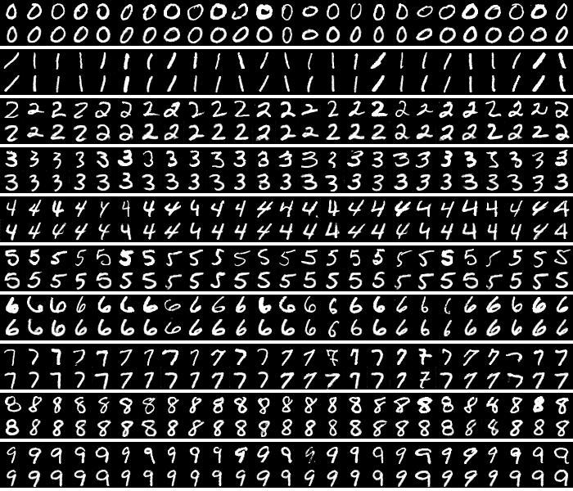
Interpreting CNN decisions on Clean Samples
Every block of two rows
First row: Input images from MNIST dataset
Notes:
Input images from MNIST dataset.
Every row has images sampled from a particular label

Slide 14
Interpreting CNN decisions on Clean Samples
Every block
First row: Input images from MNIST dataset
Second row: activated codewords on MNIST dataset
Activated codewords are similar in shape and orientation to input samples
Notes:
Activated codewords are semantically similar to input image

Slide 15
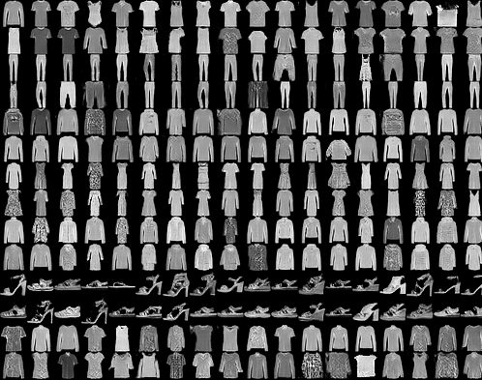
Visualization of Semantic Dictionaries
Learned codewords per class on FMNIST dataset
airplane
Codewords captures different shapes and orientation in the dataset
Codebook

Slide 16
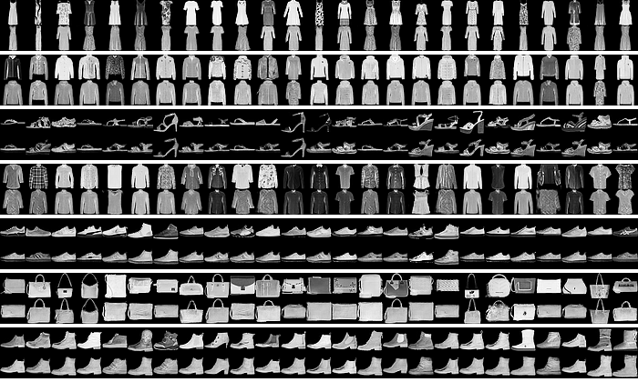
Interpreting CNN decisions on Clean Samples
Every block of two rows
First row: Input images from MNIST dataset

Slide 17
Interpreting CNN decisions on Clean Samples
Every block
First row: Input images from MNIST dataset
Second row: activated codewords on MNIST dataset

Slide 18
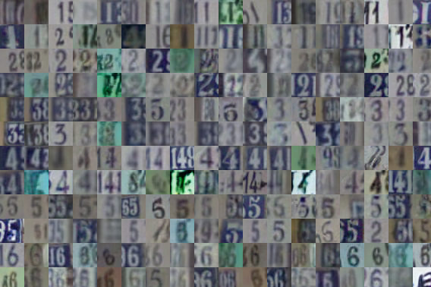
Visualization of Semantic Dictionaries
Learned codewords per class on SVHN dataset
airplane
Codewords captures variance present in the dataset
Codebook

Slide 19
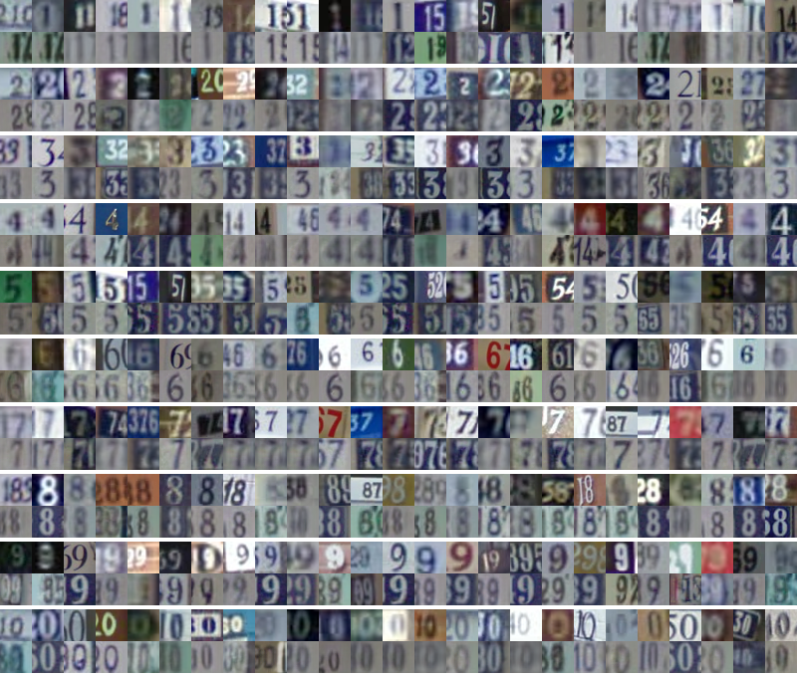
Interpreting CNN decisions on Clean Samples
Every block of two rows
First row: Input images from SVHN dataset

Slide 20
Interpreting CNN decisions on Clean Samples
Every block
First row: Input images from SVHN dataset
Second row: activated codewords on SVHN dataset

Slide 21
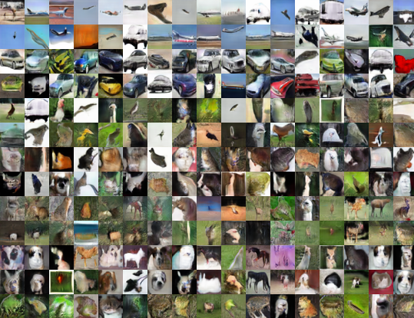
Visualization of Semantic Dictionaries
airplane
Learned codewords on CIFAR-10 dataset, ordered by class labels
Codebook

Slide 22
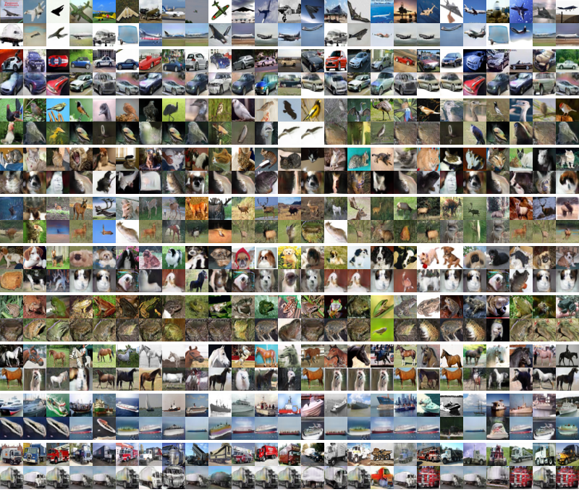
Interpreting CNN decisions on Clean Samples
Every block of two rows
First row: Input images from CIFAR-10 dataset
Activated codewords are similar to class label of the input image

Slide 23
Interpreting CNN decisions on Clean Samples
Every block
First row: Input images from CIFAR-10 dataset
Second row: activated codewords on CIFAR-10 dataset

Slide 24
Adversarial Attack Detection

Slide 25
Adversarial Attack Detector
Computes similarity between activated visual codeword and input image using a Siamese network
Normal Pair
Adversarial Pair
Input image
Clean or Adversarial
Activated codeword
Notes:
Pass the input image and activated visual codeword to the detector.
Detector is a Siamese network trained to compare the similarity between the image
The Activated codewords for adversarial samples are visually dissimilar

Slide 26
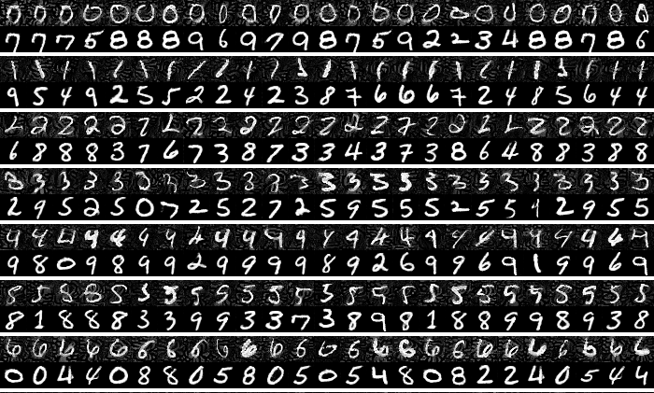
Interpreting CNN decisions on Adversarial Samples (IFGSM)
Every block of two rows
First row: Adversarial images from MNIST dataset
Notes:
adversarial sampels generated using Iterative fast gradient sign method (IFGSM)

Slide 27
Interpreting CNN decisions on Adversarial Samples (IFGSM)
Every block
First row: Input images from MNIST dataset
Second row: activated codewords on MNIST dataset
Activated codewords are dissimilar to input image in class labels
Notes:
We observe that activated codewords are not similar to input image and hence we cast adversarial detection as a image similarity problem with the input image

Slide 28
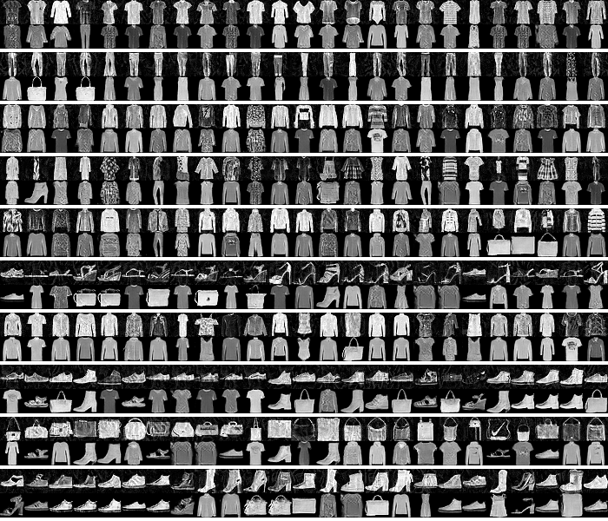
Interpreting CNN decisions on Adversarial Samples (IFGSM)
Every block of two rows
First row: Adversarial images from FMNIST dataset
Notes:
adversarial sampels generated using Iterative fast gradient sign method (IFGSM)

Slide 29
Interpreting CNN decisions on Adversarial Samples (IFGSM)
Every block
First row: Input images from FMNIST dataset
Second row: activated codewords on FMNIST dataset
Activated codewords are dissimilar to input image in class labels
Notes:
adversarial sampels generated using Iterative fast gradient sign method (IFGSM)

Slide 30
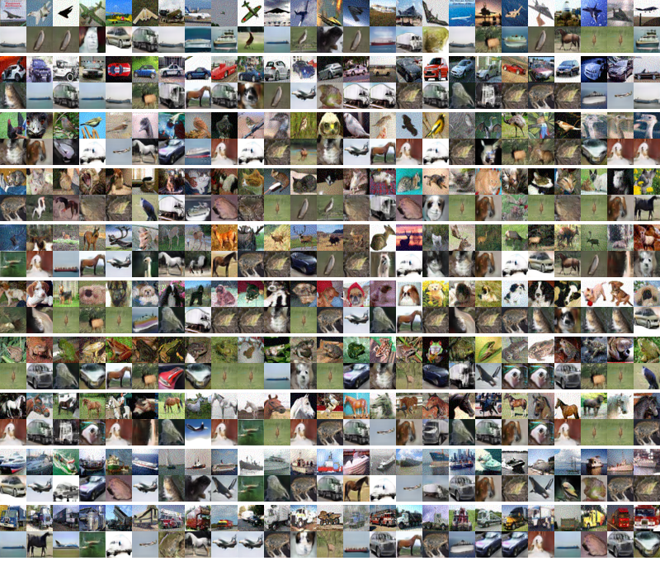
Interpreting CNN decisions on Adversarial Samples (IFGSM)
Every block of two rows
First row: Adversarial images from CIFAR dataset
Notes:
adversarial sampels generated using Iterative fast gradient sign method (IFGSM)

Slide 31
Interpreting CNN decisions on Adversarial Samples (IFGSM)
Every block
First row: Input images from CIFAR dataset
Second row: activated codewords on CIFAR dataset
Activated codewords are dissimilar to input image in class labels
Notes:
adversarial sampels generated using Iterative fast gradient sign method (IFGSM)

Slide 32
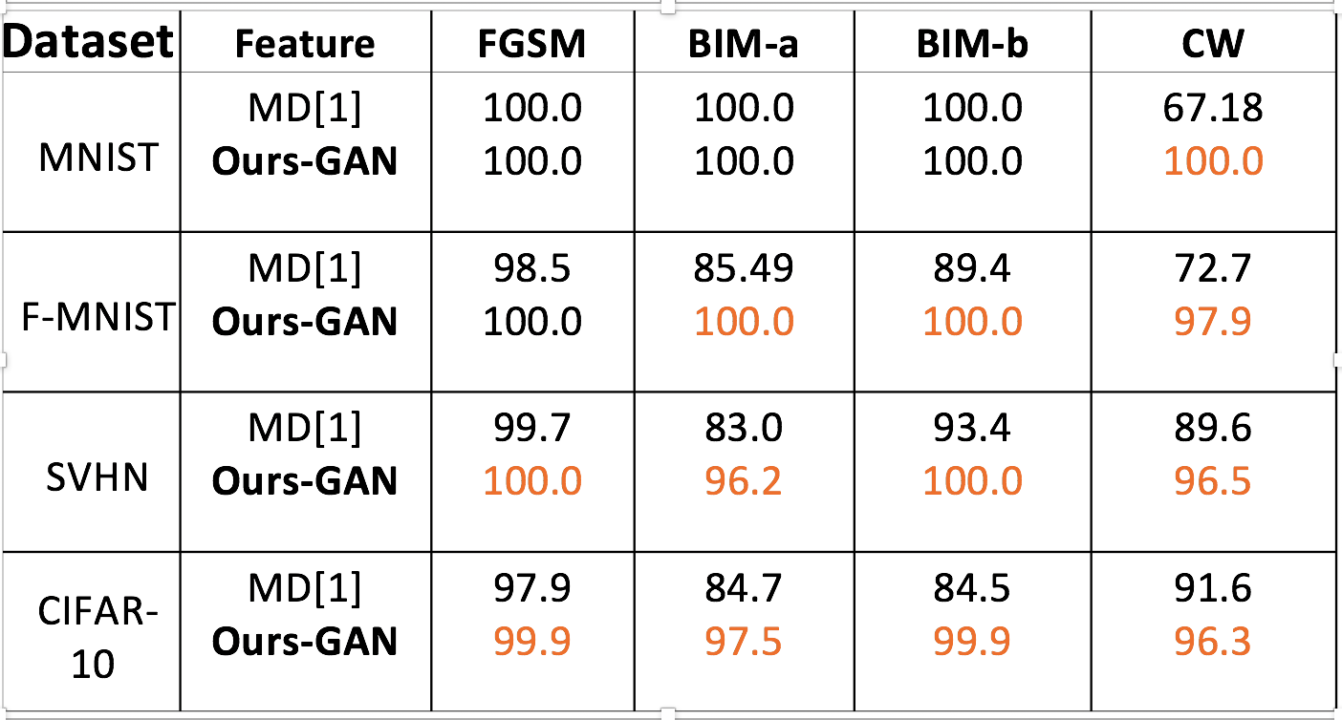
Results
Adversarial Attack Detection on BoW Networks
AUROC
1. K. Lee, K. Lee, H. Lee, and J. Shin. A simple unified framework for detecting out-of-distribution samples and adversarial Attacks, NIPS 2018
Adversarial Attack Detection on BoW Networks
Notes:
WHITE BOX CLASSIFER BUT DETECTOR iS BLACKBOX
Our work outperforms the MD- Mahalanobis distance based attack detection. Mahalanobis distance is computed between the features and prelearnt gaussian centeres.
Normal samples are close to gaussian centers while the adversarial samples are away from the gaussian centers
BIM-a: Basic iterative method with fast gradient sign method run for fixed iterations
BIM-b: Same as BIM-a except the gradient updates are stopped at iterations as soon input image is fooled
CW: Carlini wagner optimization attack, powerful

Slide 33
Results
Adversarial Attack Detection on BoW Networks
AUROC
1. K. Lee, K. Lee, H. Lee, and J. Shin. A simple unified framework for detecting out-of-distribution samples and adversarial Attacks, NIPS 2018
Adversarial Attack Detection on BoW Networks
Notes:
WHITE BOX CLASSIFER BUT DETECTOR iS BLACKBOX
Our work outperforms the MD- Mahalanobis distance based attack detection. Mahalanobis distance is computed between the features and prelearnt gaussian centeres.
Normal samples are close to gaussian centers while the adversarial samples are away from the gaussian centers
BIM-a: Basic iterative method with fast gradient sign method run for fixed iterations
BIM-b: Same as BIM-a except the gradient updates are stopped at iterations as soon input image is fooled
CW: Carlini wagner optimization attack, powerful

Slide 34
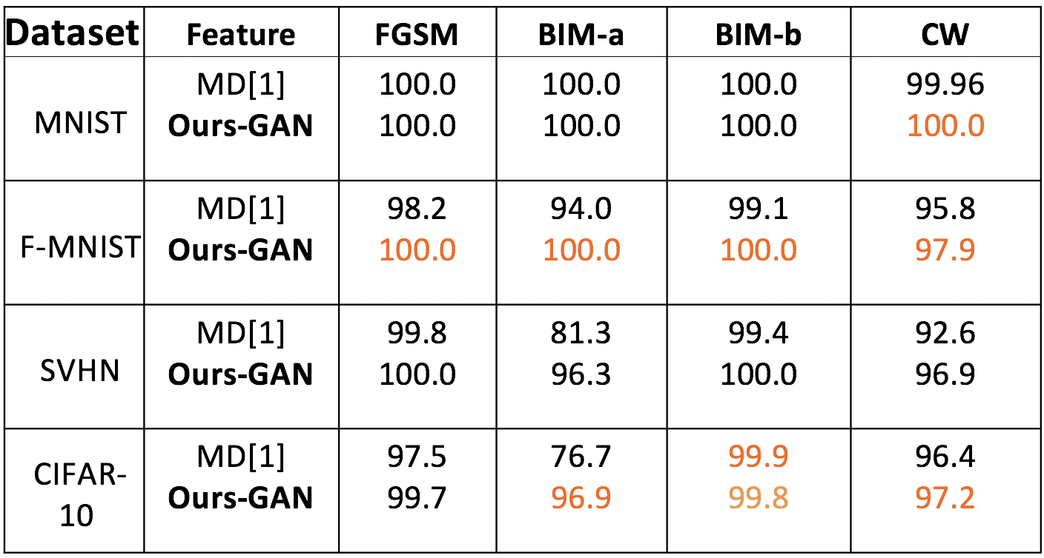
Results
Adversarial Attack Detection on Base Networks
AUROC
1. K. Lee, K. Lee, H. Lee, and J. Shin. A simple unified framework for detecting out-of-distribution samples and adversarial Attacks, NIPS 2018
Adversarial Attack Detection on BoW Networks
Notes:
WHITE BOX CLASSIFER BUT DETECTOR iS BLACKBOX
Our work outperforms the MD- Mahalanobis distance based attack detection. Mahalanobis distance is computed between the features and prelearnt gaussian centeres.
Normal samples are close to gaussian centers while the adversarial samples are away from the gaussian centers

Slide 35
Results
Adversarial Attack Detection on Base Networks
AUROC
1. K. Lee, K. Lee, H. Lee, and J. Shin. A simple unified framework for detecting out-of-distribution samples and adversarial Attacks, NIPS 2018
Adversarial Attack Detection on BoW Networks
Notes:
WHITE BOX CLASSIFER BUT DETECTOR iS BLACKBOX
Our work outperforms the MD- Mahalanobis distance based attack detection. Mahalanobis distance is computed between the features and prelearnt gaussian centeres.
Normal samples are close to gaussian centers while the adversarial samples are away from the gaussian centers

Slide 36
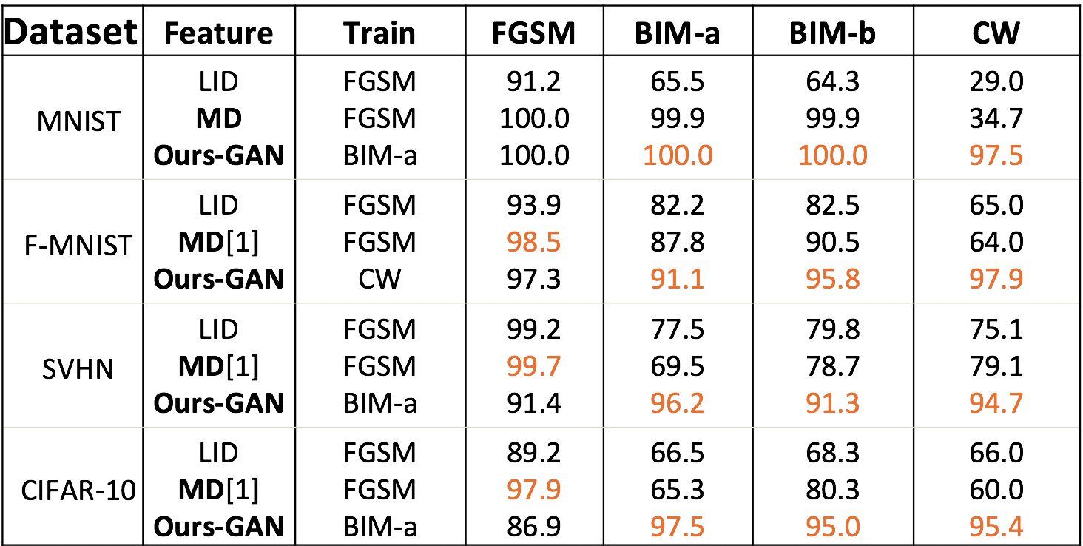
Results
Generalization to Different Attacks
AUROC
1. K. Lee, K. Lee, H. Lee, and J. Shin. A simple unified framework for detecting out-of-distribution samples and adversarial Attacks, NIPS 2018
Adversarial Attack Detection on BoW Networks
Notes:
In this table, we show that
An detector trained with BIM-a in our case generalizes well to other attacks.

Slide 37
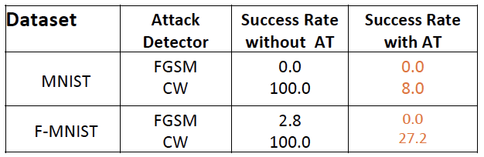
Results
White Box Detector Attacks
Expose the detector network to attacker
accuracy
Adversarial training (AT) of the detector makes robust to white box detector attackls
Adversarial Attack Detection on BoW Networks
Notes:
Success rate of fooling detector by exposing it to attacker is very high in CW optimization attack (third column)
By adversarially training the detector on the fly, we make it robust , although CW attack is still successful in fooling the detector ( 8% rate on MNIST, 27% on FMNIST)

Slide 38
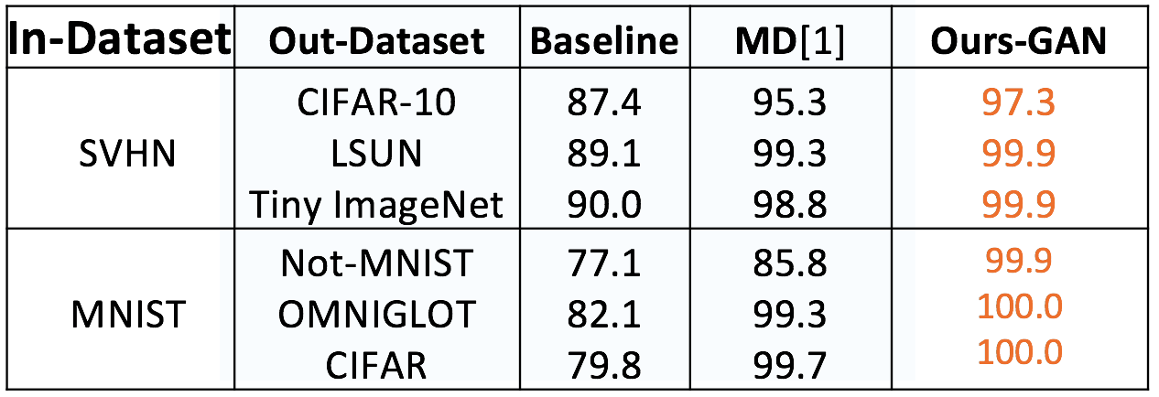
Results
Detecting Out-of-distribution Samples
AUROC
1. K. Lee, K. Lee, H. Lee, and J. Shin. A simple unified framework for detecting out-of-distribution samples and adversarial Attacks, NIPS 2018
Adversarial Attack Detection on BoW Networks
Notes:
We detect the out of distribution samples by passing the input image and activated codeword.
For out of distribution datasets, the samples are visually dissimilar to activated codewords of In-distribution classes.

Slide 39
Results
Detecting Out-of-distribution Samples
AUROC
1. K. Lee, K. Lee, H. Lee, and J. Shin. A simple unified framework for detecting out-of-distribution samples and adversarial Attacks, NIPS 2018
Adversarial Attack Detection on BoW Networks
Notes:
We detect the out of distribution samples by passing the input image and activated codeword.
For out of distribution datasets, the samples are visually dissimilar to activated codewords of In-distribution classes.
Baseline : max confidence of the softmax layer

Slide 40
Conclusion
By providing visual representation to BoW codeword filters in deep CNNs,
We interpret the decisions of a CNN
Leverage the activated codewords to detect adversarial and Out of distribution examples
Notes:
1.Understanding internal dynamics of neural network predictions through semantic codewords
2. Leverage semantic codewords to detect adversarial samples

Slide 41
Thank You

Slide 42
Multi-stage Training
End-to-end Training
ConvNet Features + SVMs
MultiScale Orderless Pooling [Gong et al., 2014]
Deep Structured Representation
NetVLAD [Arandjelović et al., 2016]
FisherNet [Peng et al., 2017]
^{Stage 1}
^{Stage 2}
^{End-to-end}
^{Features}
^{VLAD+SVMs}
Joint Feature + Classification
Notes:
Peng et al: End to End Fisher representation in Deep CNN

Slide 43
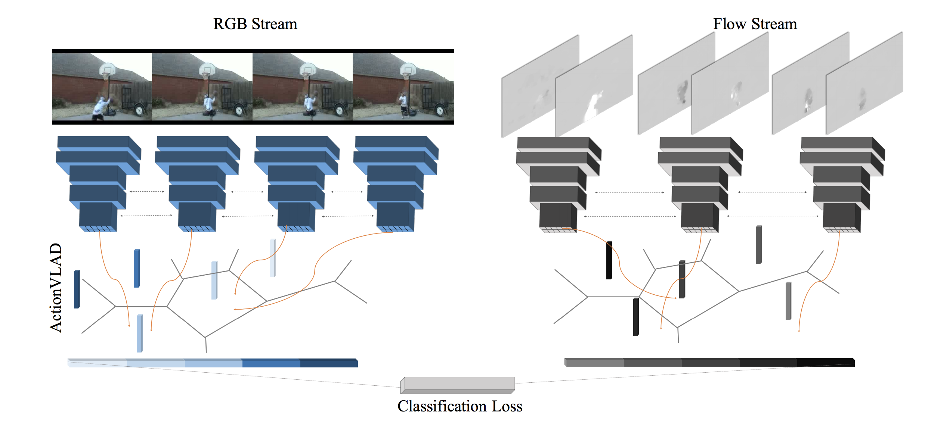
Action VLAD: Spatio-temporal aggregation
Action recognition
Cluster centers
Features are pooled across space and time using the ActionVLAD pooling layer
Rohit et al., ActionVLAD: Learning spatio-temporal aggregation for action classification, 2017
Notes:
Action VLAD: bi stream network to recognize actions. One for RGB and one for optical flow.

